Slide 1
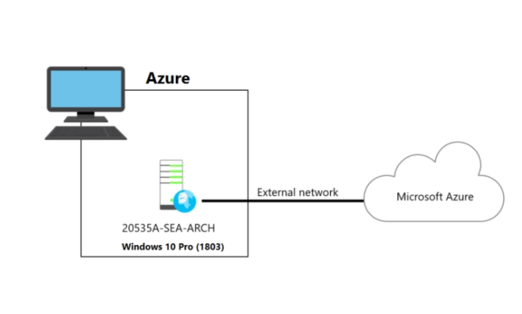
AZURE CLOUD COMPUTING
MINOR PROJECT

Slide 2
Topics:
Create 2 Venets – Vnet 1 and Vnet 2.
Create 2 Subnets in each Vnet.
Create VM each Vnet 1 and 2.
Assign Public IP to VM in Vnet1.
Peer Vnet 1 and 2.
Login to VM1 and if peering is succesful you should be able to login to VM in Vnet 2.
Create a data disk and attach to VM1.
Logon to VM and initialize the disk.

Slide 3
CREATE 2 Vnets- Vnet1 and Vnet2
Internet
Microsoft azure portal.
Virtual Network
ADD
Vnet1
Vnet2
Basics
IP Adress
Security
Tags
Review + Create
Basics
IP Adress
Security
Tags
Review + Create
Vnet 1 and 2 is created

Slide 4
Create 2 Subnets in each Vnet
Vnet 1
Vnet 2
IP Address
IP Address
Add Subnet
Add Subnet
Add Subnet_1 and Subnet_2
Add Subnet_1 and Subnet_2
Select Next
Select Next

Slide 5
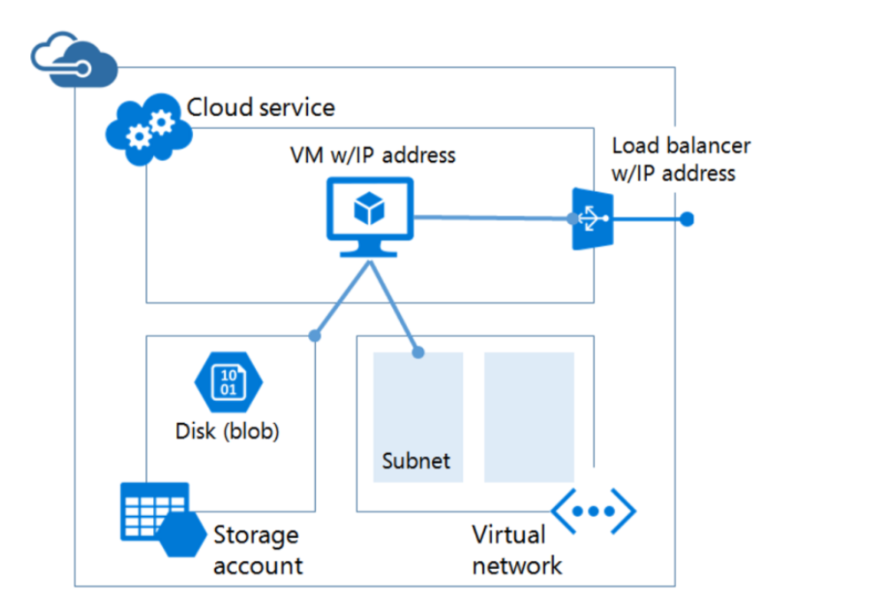
Create VM each Vnet 1 and 2.
Vnet1
Vnet2

Slide 6
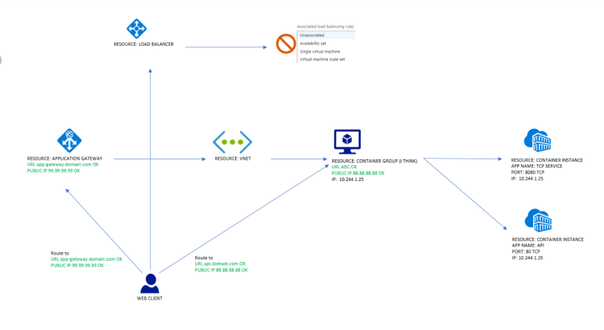
Assign Public IP to VM in Vnet1

Slide 7


Peer Vnet 1 and 2
Vnet1
Vnet2
10
1
10.0.0.0/16
10.10.0.0/19
subnet
subnet
Vnet 1 and 2
peering connection.

Slide 8
Create a Data Disk and link to VM1
VM1
Data Disk

Slide 9
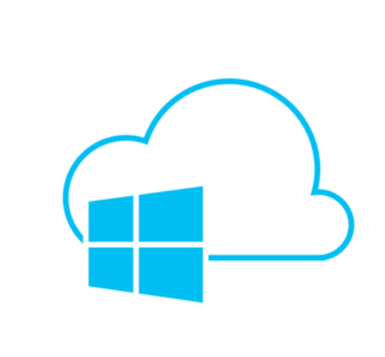
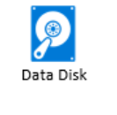

Azure cloud VM1
Device

Slide 10

DEVATHA SHIVSHYL
7892683349

